Slide 1
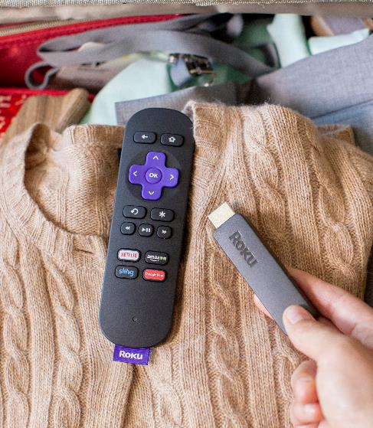
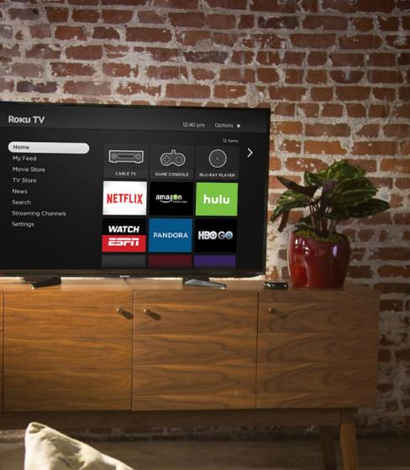
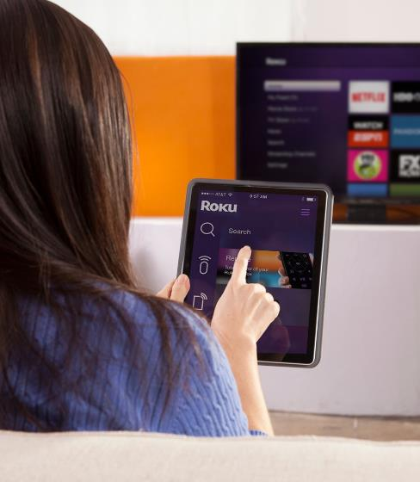
Design for the High End,
Gracefully Degrade for Low End
Ali Vassigh, VP of UX

Slide 2

Introduction
This presentation contains a small subset of info for creating a well-designed Roku Channel.
For more info, please read our Design & User Experience Guidelines:
https://sdkdocs.roku.com/display/sdkdoc/Design+and+User+Experience+Guidelines

Slide 3
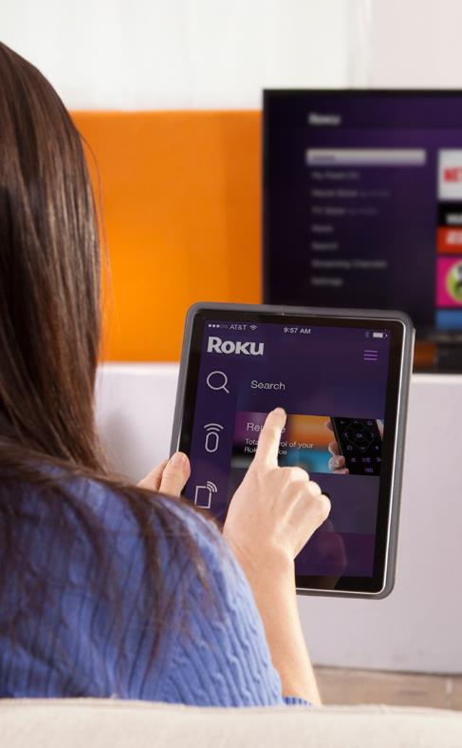
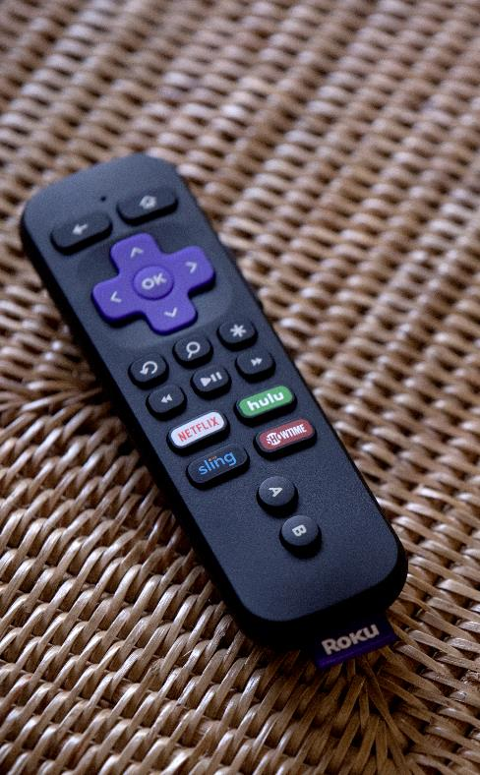
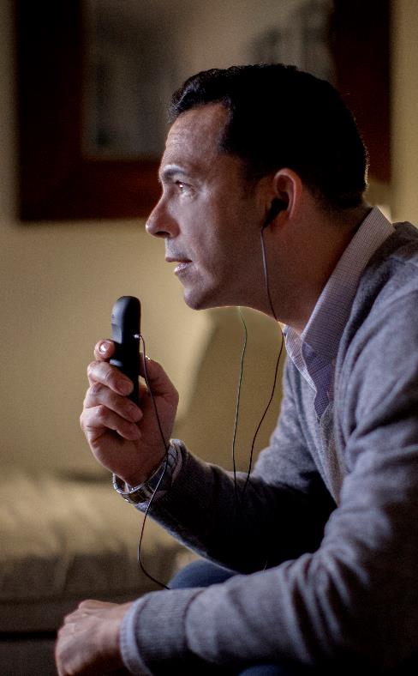
Process & Research

Slide 4

Overview
Small up-stream investment
Big down-stream payoff
What is success?

Slide 5
Process & Research
Interview clients
Know the audience
User testing
Notes:
Interview your clients — Get to know what your client is looking for in their product. In many cases, the client is a product manager, publisher, or content creator. They may not be an expert on Roku channel development in particular, or the OTT industry as a whole. As their designer/developer, you can provide your expertise to ensure the channel is optimized for the Roku platform and the “living room” streaming experience.
Know the audience — The audience is the end-user; the person consuming content in the channel. Get to know the content in the channel and how users consume it. Do they binge entire seasons at once, watch new episodes when they’re posted each week, or only follow their favorite characters? Understanding these consumption habits will inform the navigation and UI of the channel, so that users can get the content exactly how they want it. For example, a show that’s often binged might make sense to start at Season 1 Episode 1 and implement continuous playback from one episode to the next. On the other hand, it might make sense to display episodes in reverse chronological order for a popular show that’s currently airing new episodes, so viewers can quickly find the most recent episode.
User testing — Once you have some mockups or a proof of concept, ask a few users to spend 15 minutes interacting with the channel. Give them a specific task and observe how quickly they complete it. Ask them to find a specific piece of content and monitor how they go about searching for it. After just a few user tests, you’ll already see common pitfalls. Just testing on approximately 10 users should be a significant sample size — no need for a massive data set.

Slide 6
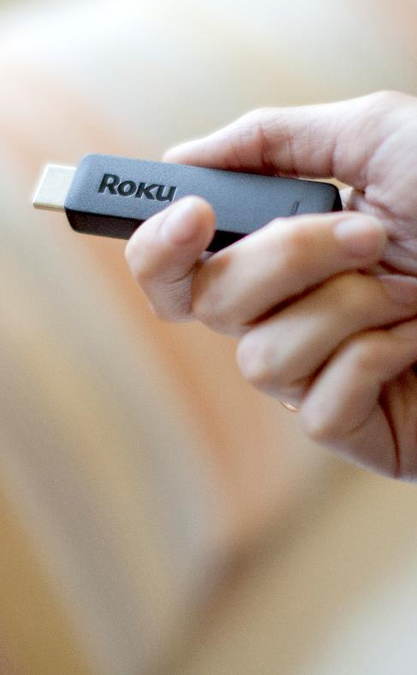
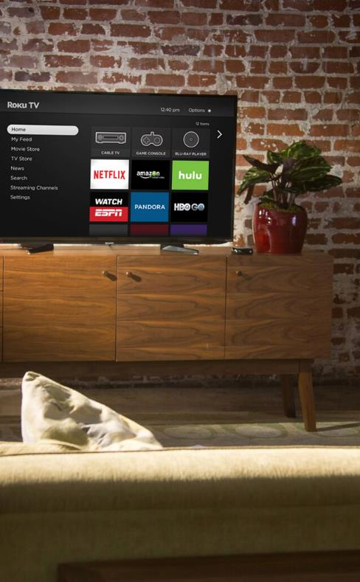
Design for high and low-end devices

Slide 7

Overview
Intentionally designing for the lowest-common denominator means all users receive a compromised channel experience, even those with a premium device.
Create a great design that takes advantage of the high-end products while gracefully degrading for lower-end products to ensure core functionality.
Notes:
Users who paid the extra money for a high-performing product should not receive a compromised experience just because the channel also runs on devices with lower hardware specs. Develop a rich, beautiful channel that takes full advantage of high-end capabilities, yet make it dynamic enough to detect when it’s on a device with lower specs and modify features accordingly. In many cases, this can be handled server-side, such as serving lower-quality assets on low-end devices.

Slide 8
Simple UI examples
Loading spinners / indicator
Alpha gradients
Screen transitions

Slide 9
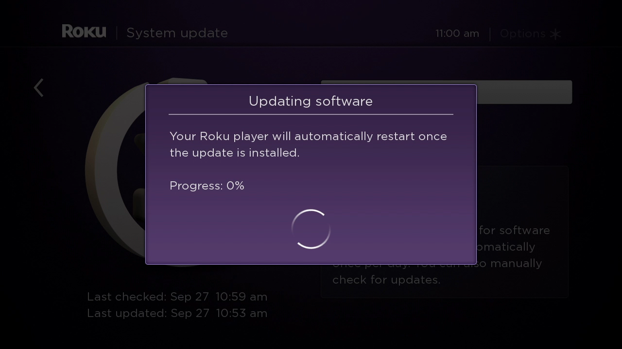
Loading spinners (high-end)
Notes:
Use smooth animations on high-end products, but use choppy animations (or no animations at all) on the low-end

Slide 10
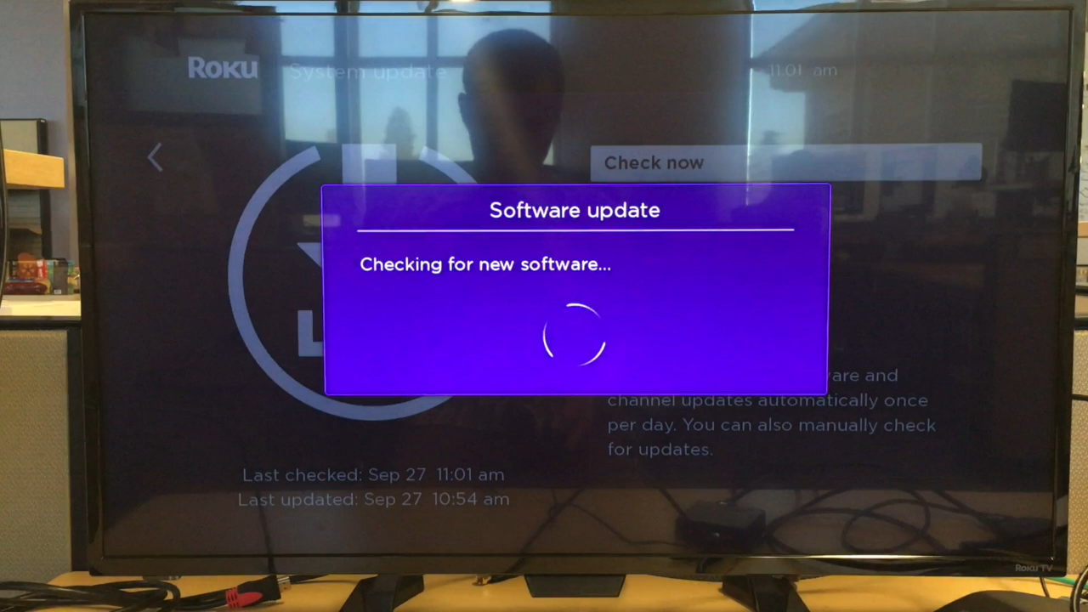
Loading spinners (low-end)
Notes:
Use smooth animations on high-end products, but use choppy animations (or no animations at all) on the low-end

Slide 11
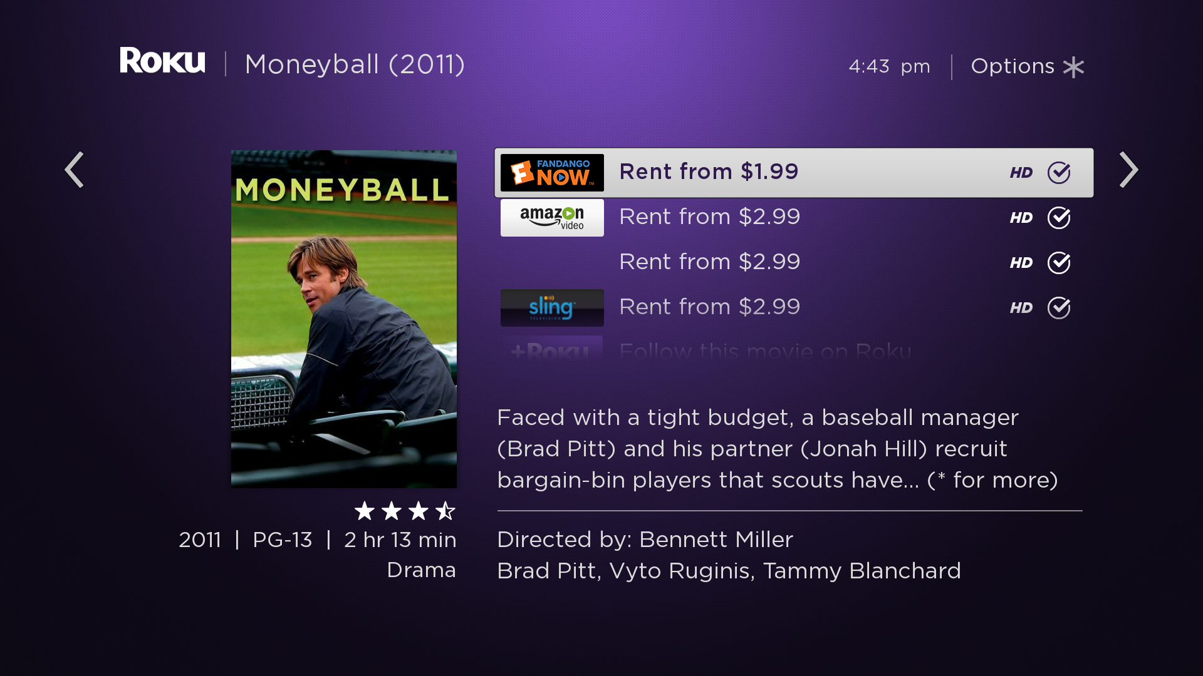
Alpha mask (high-end)
Notes:
Use alpha-masking on the high-end, but turn that feature off on the low-end. Instead, you can still hint there’s more content to be seen by having the content peak out “above the fold” before being cut off

Slide 12
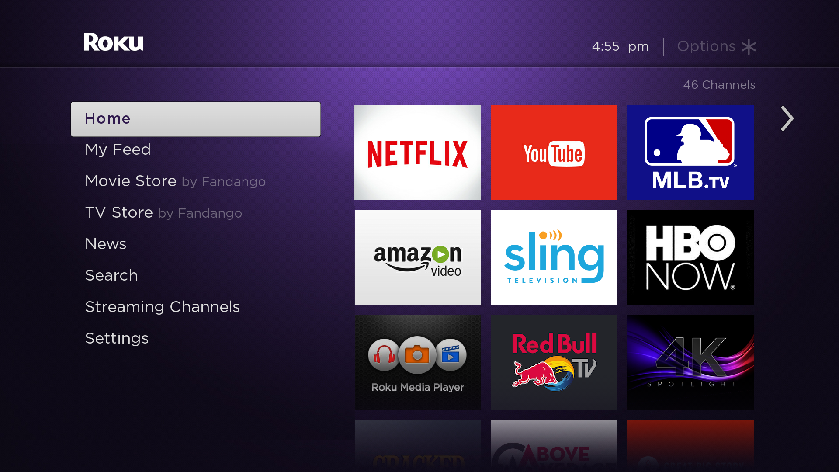
Alpha mask (high-end)
Notes:
Use alpha-masking on the high-end, but turn that feature off on the low-end. Instead, you can still hint there’s more content to be seen by having the content peak out “above the fold” before being cut off

Slide 13
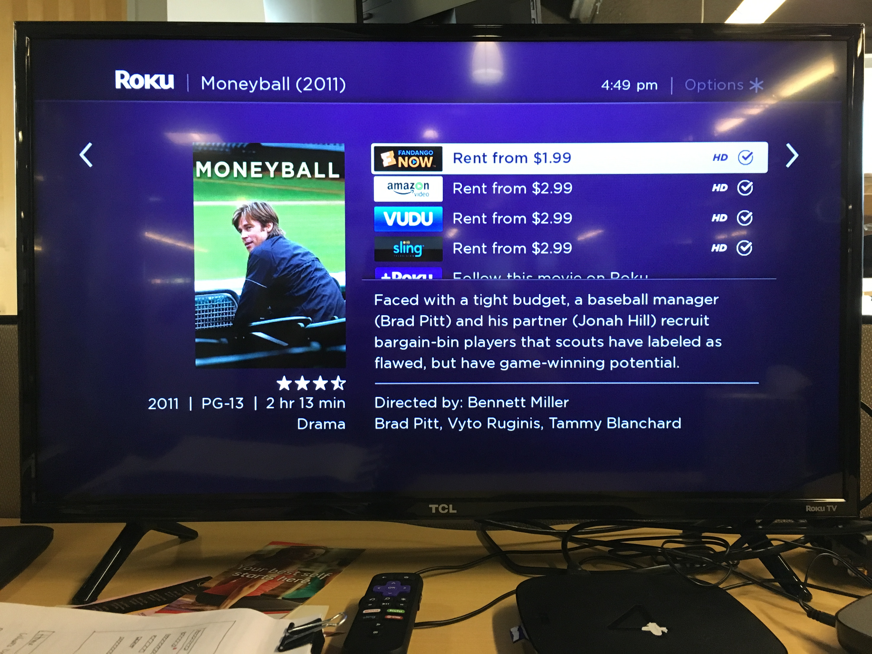
Utilize cropping (low-end)
Notes:
Use alpha-masking on the high-end, but turn that feature off on the low-end. Instead, you can still hint there’s more content to be seen by having the content peak out “above the fold” before being cut off

Slide 14
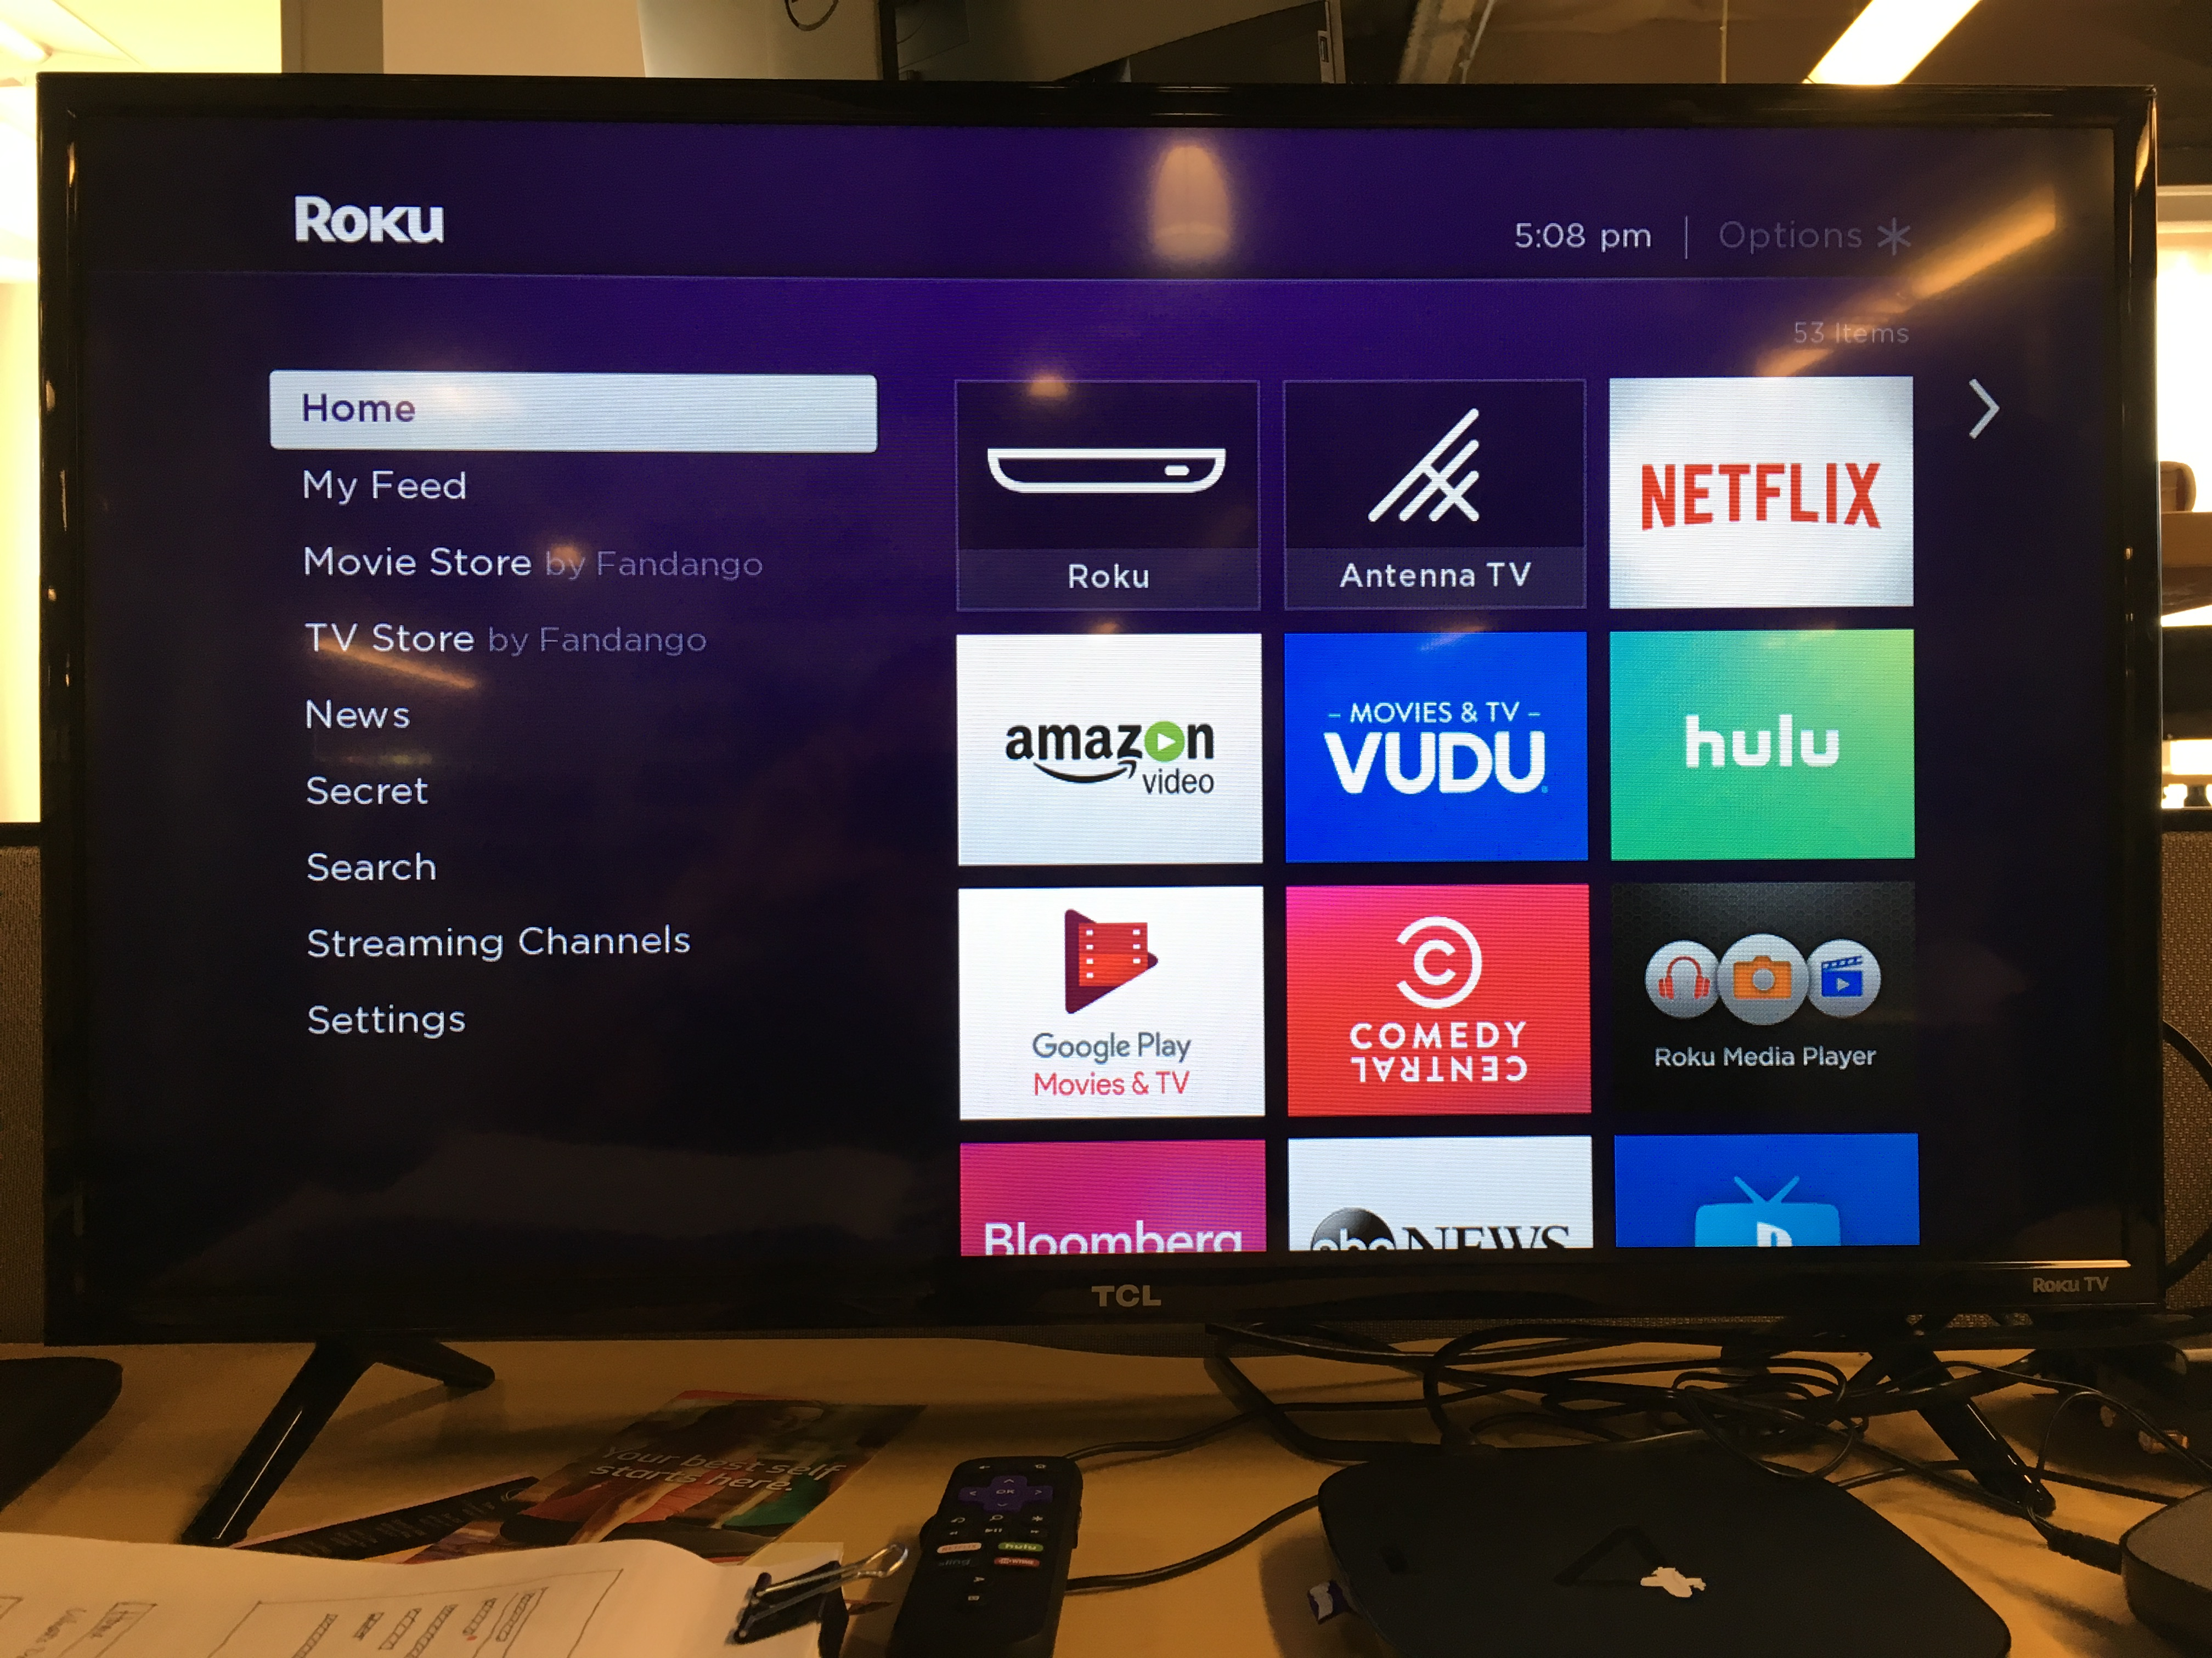
Utilize cropping (low-end)
Notes:
Use alpha-masking on the high-end, but turn that feature off on the low-end. Instead, you can still hint there’s more content to be seen by having the content peak out “above the fold” before being cut off

Slide 15
Screen Transitions
Eliminate re-orientation and analysis
as system changes state A >> B
Experiment…

Slide 16

Experiment 1: Identify the changes

Slide 18


Slide 20
Experiment 2: Identify the changes

Slide 23

Channel Showcase:
CenturyLink Stream is an excellent example of a channel that provides a feature-rich channel experience on high-end Roku devices, while also reducing the app’s feature set on the lower-end Roku devices.

Slide 24
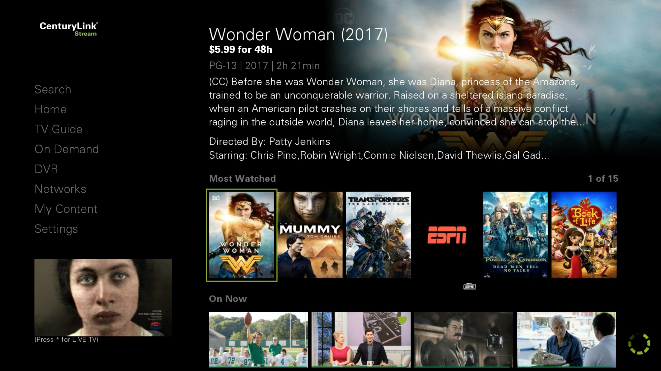
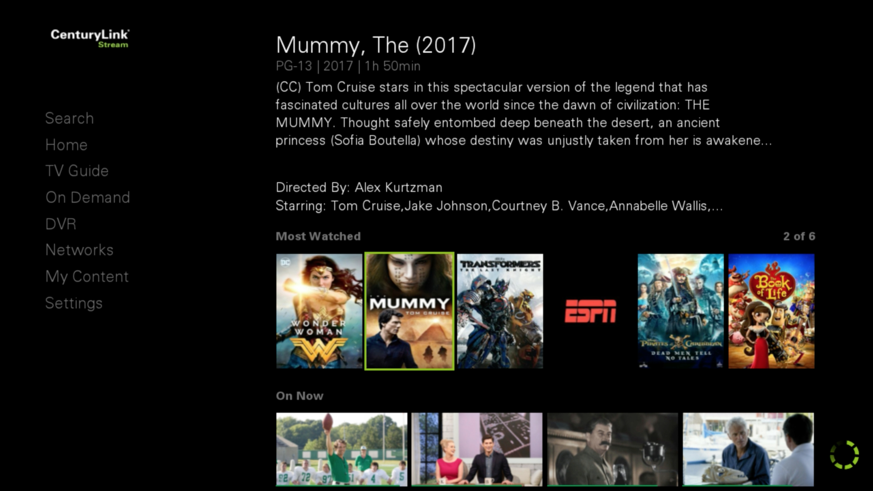
CenturyLink
High-end
Low-end
Notes:
- High-end
Able to pre-load / load more data (content tiles)
Also able to have PIP video preview
Immersive background image
Low-end
Pre-load/load less data (content tiles)
No PIP video preview
No background image

Slide 25
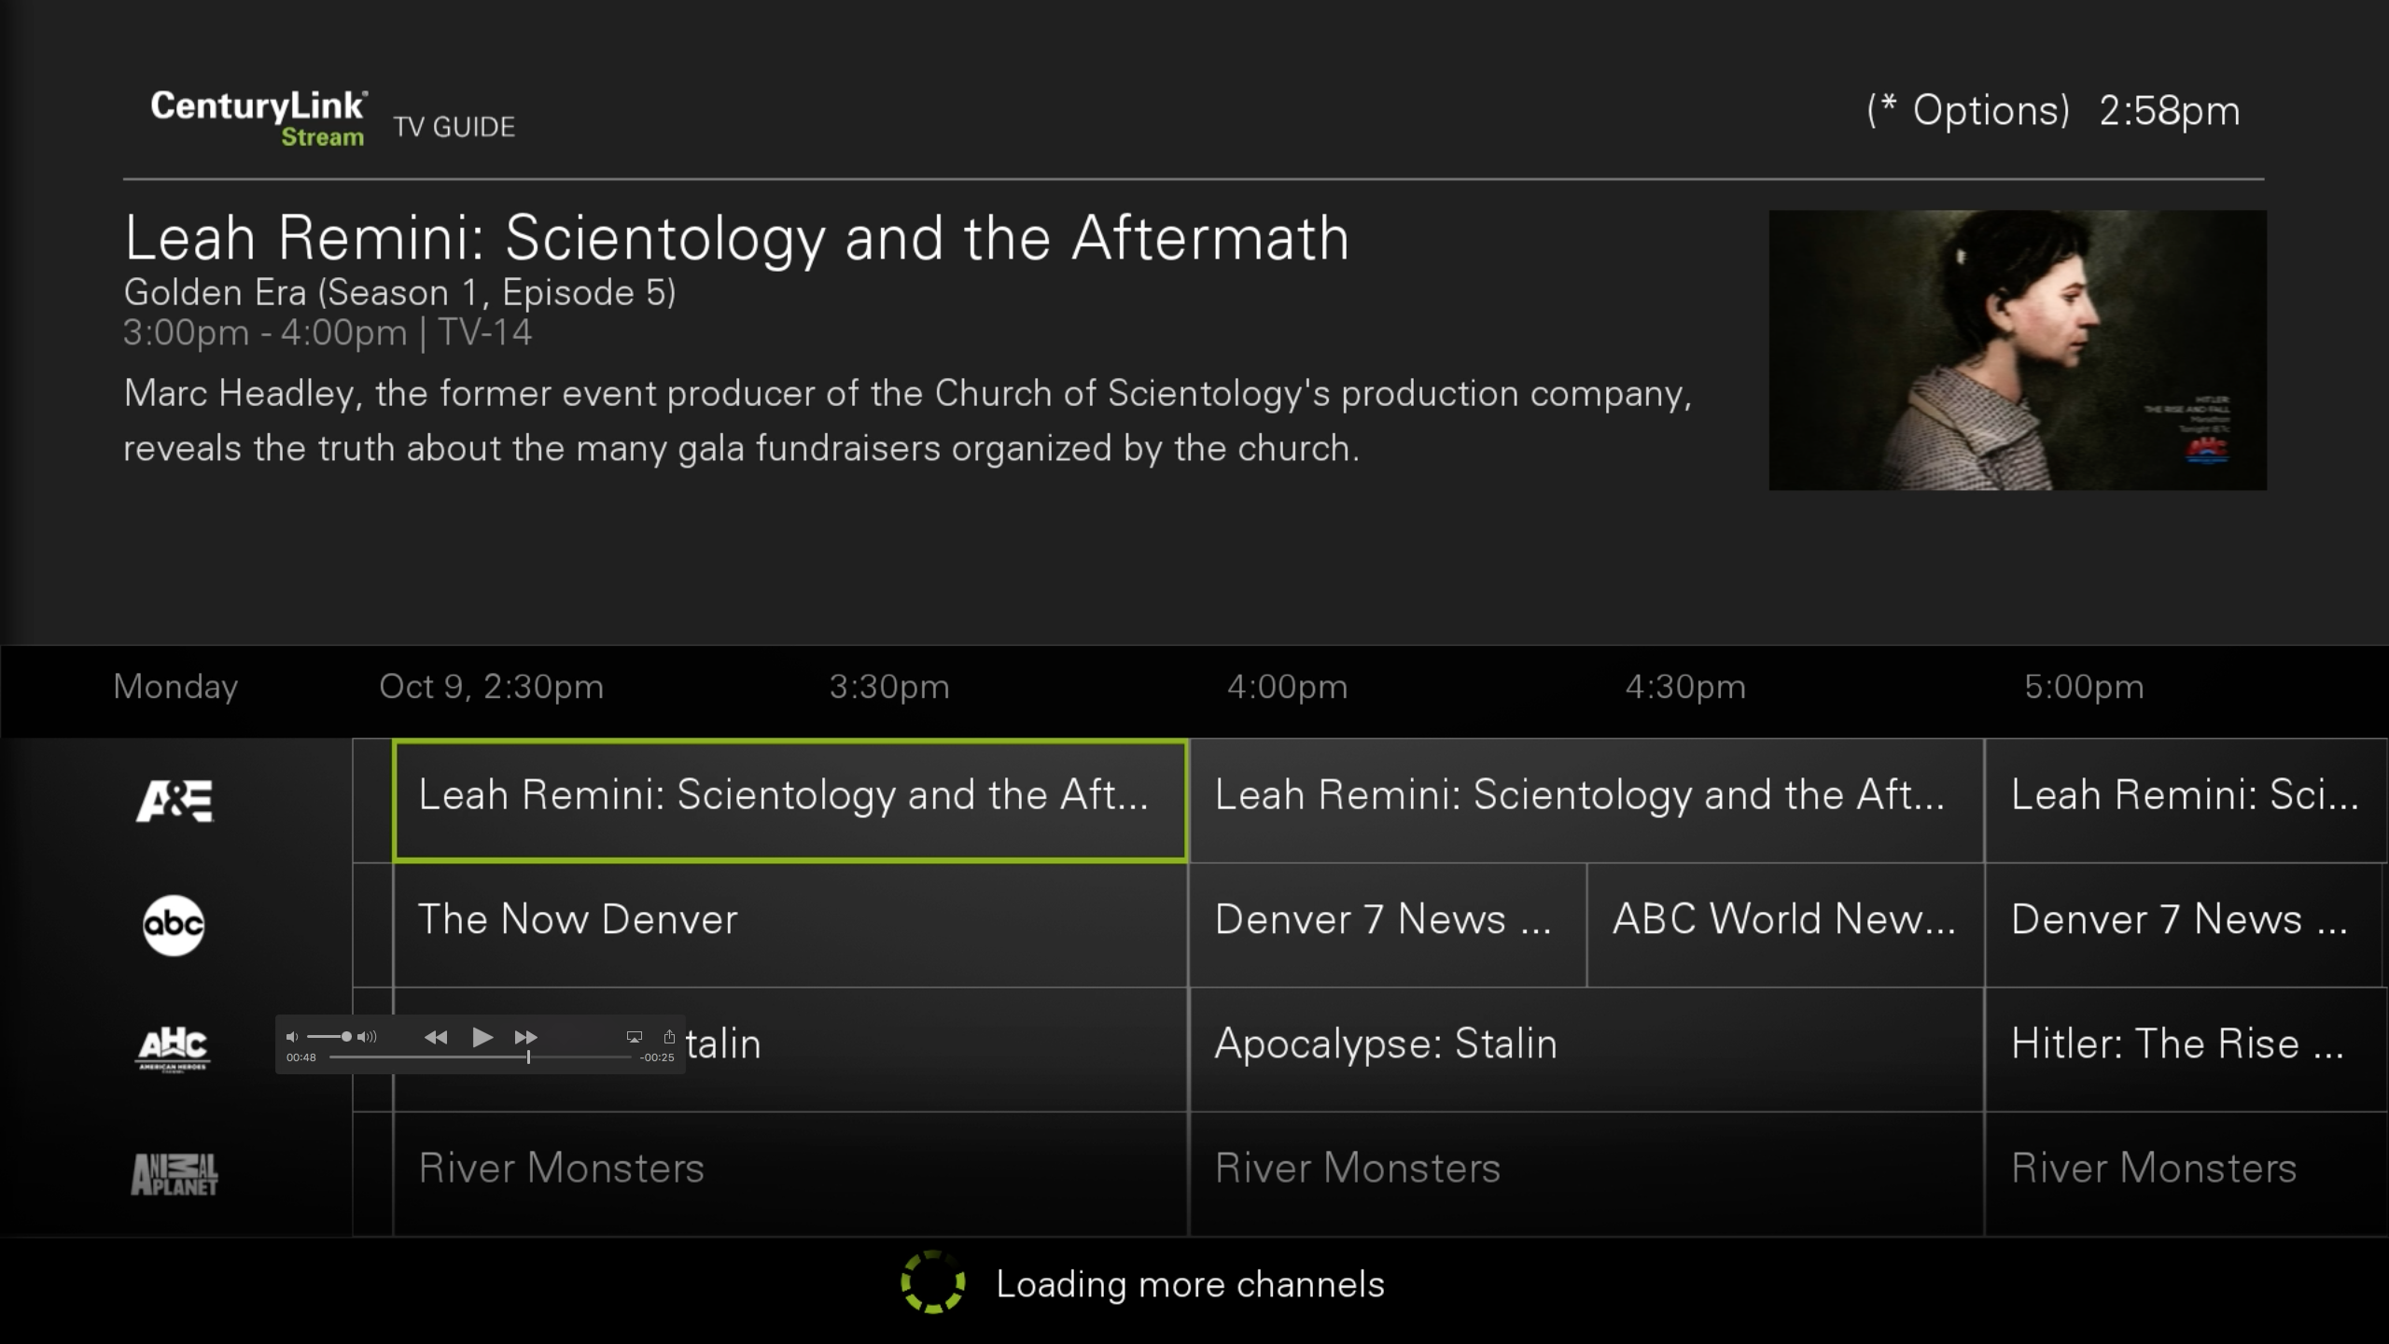
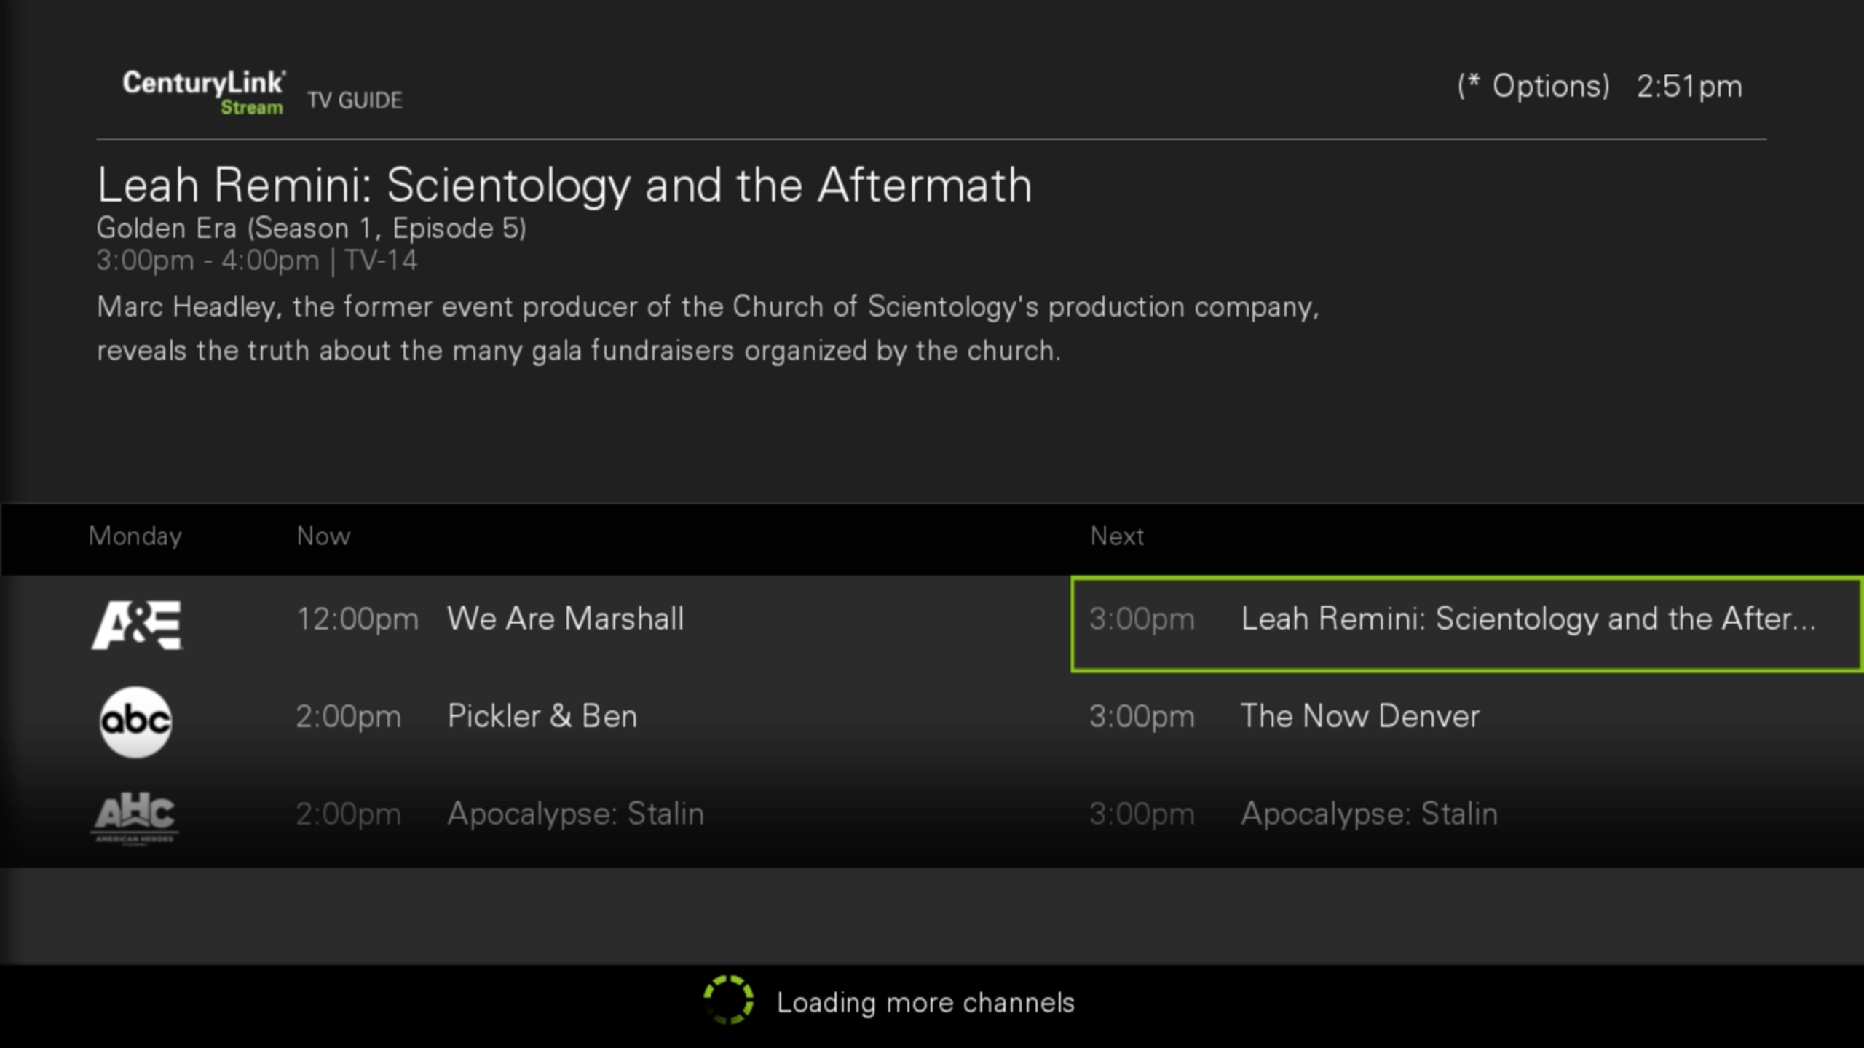
CenturyLink
High-end
Low-end
Notes:
- High-end
Able to pre-load / load more data (epg schedule/content)
Also able to have PIP video preview
Low-end
Pre-load/load less data ((epg schedule/content)
No PIP video preview

